Slide 1
Predicting Cancer Cases
By: Serena Hollis & Jordon Clements

Slide 2
Project Questions:
What demographics affect new cancer cases the most?
Are they the same as cancer mortality?
Which states are at the greatest risks?

Slide 3
Objectives:
Objectives:
Gather data sets for new cancer and cancer mortality rates
Create model to predict new cancer and cancer mortality rates
Display actual and prediction results in a map
Display demographics such as income, uninsured rate, population, and poverty rate per race

Slide 4
Our Process
Step 1
Step 2
Step 3
Step 4
Gather Data
Retrieved cancer and demographic data from National Cancer Institute and the CDC
Combine all data
Use python to create codes that would merge each individual spreadsheet into one large data sheet
Create and Test Model
Use the created spreadsheet to linear regression model to predict new cancer case numbers and cancer death numbers
Use Model
Use model on new data to test if model would be accurate on new information

Slide 5
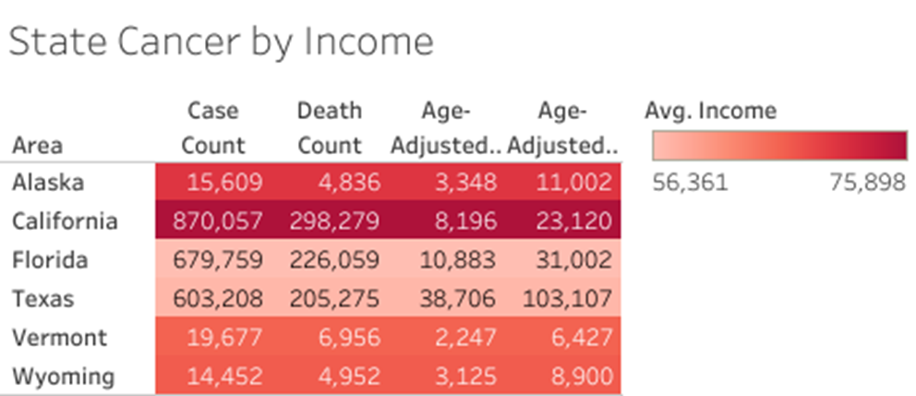

Slide 6
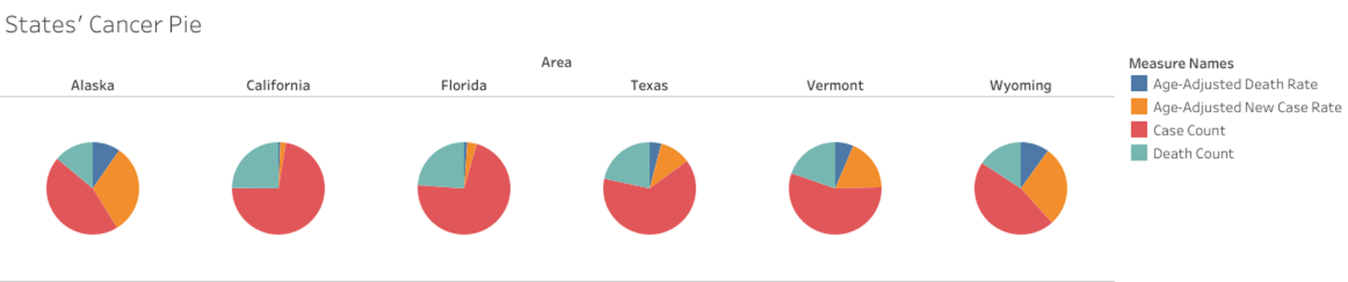

Slide 7
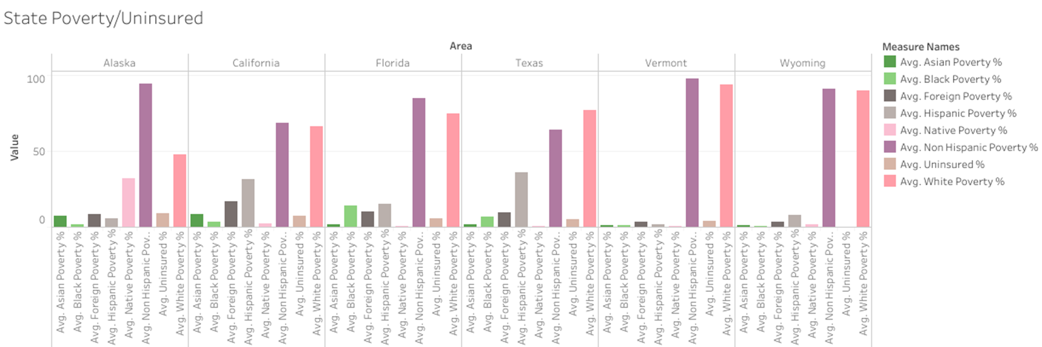

Slide 8
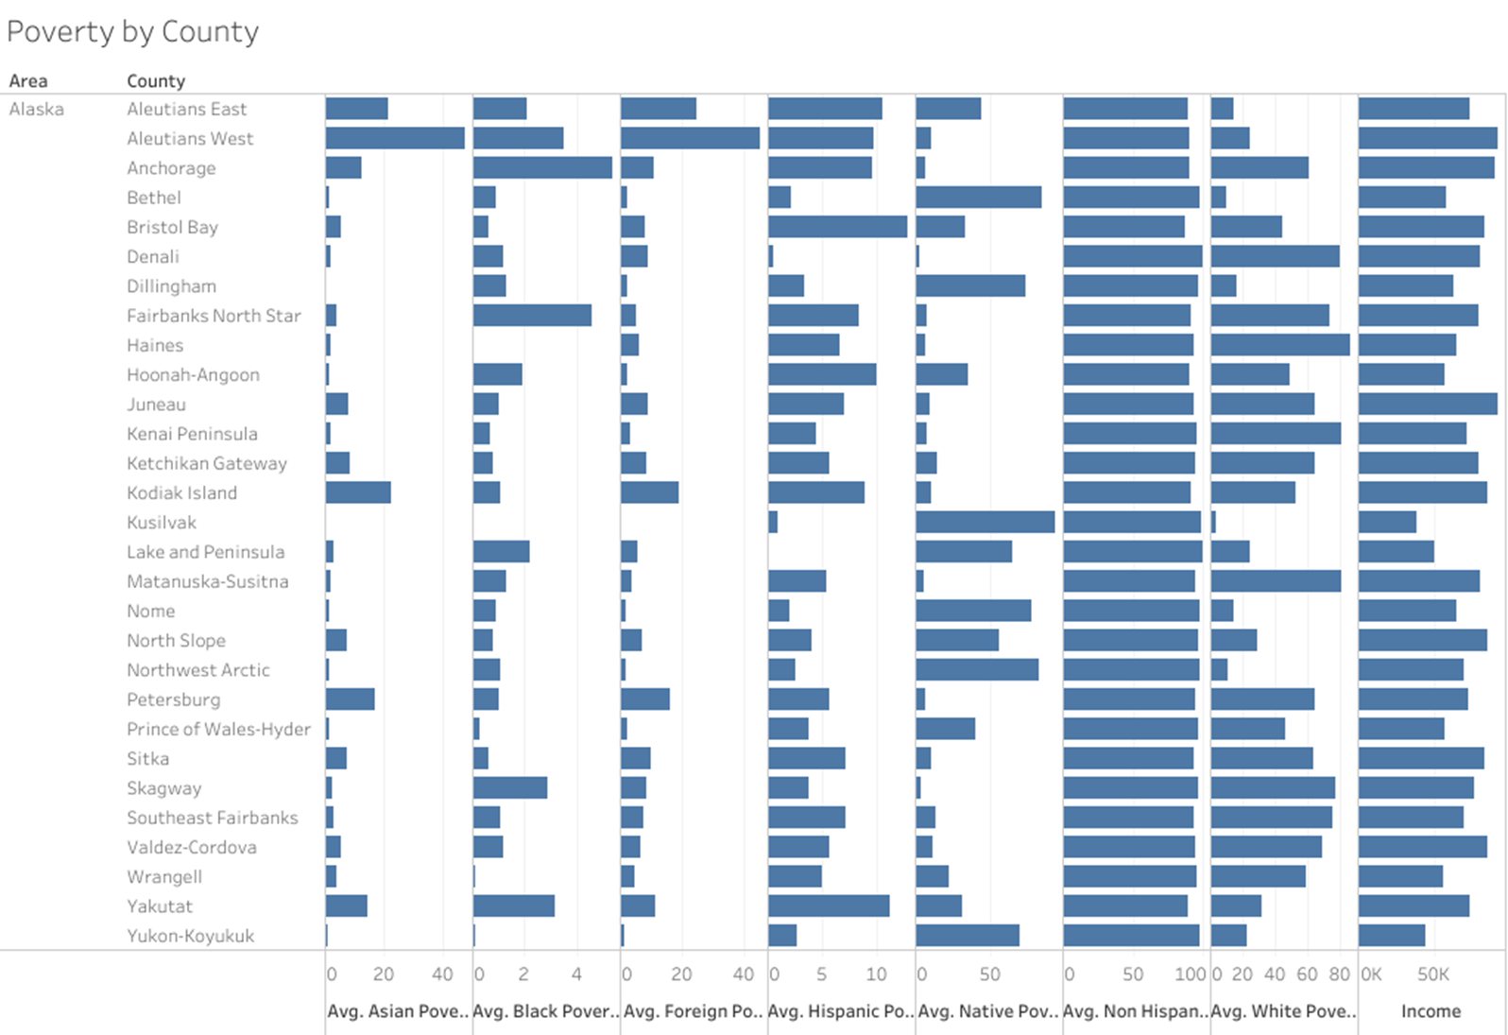

Slide 9
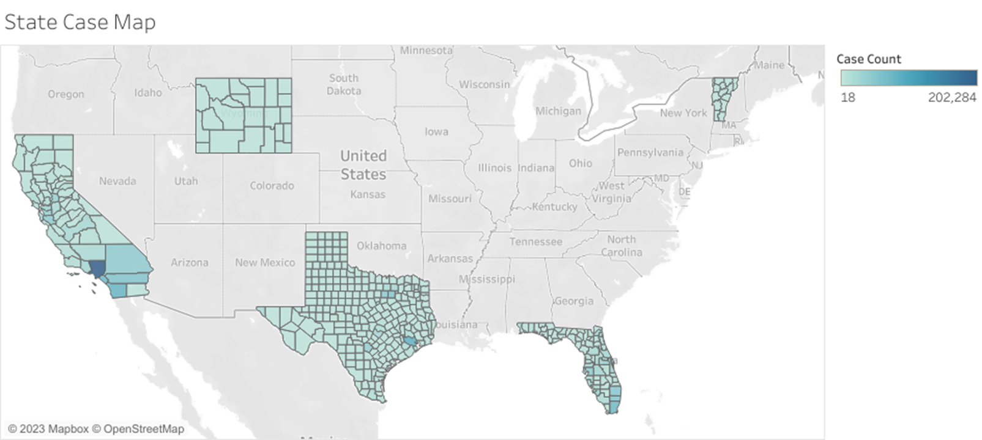

Slide 10
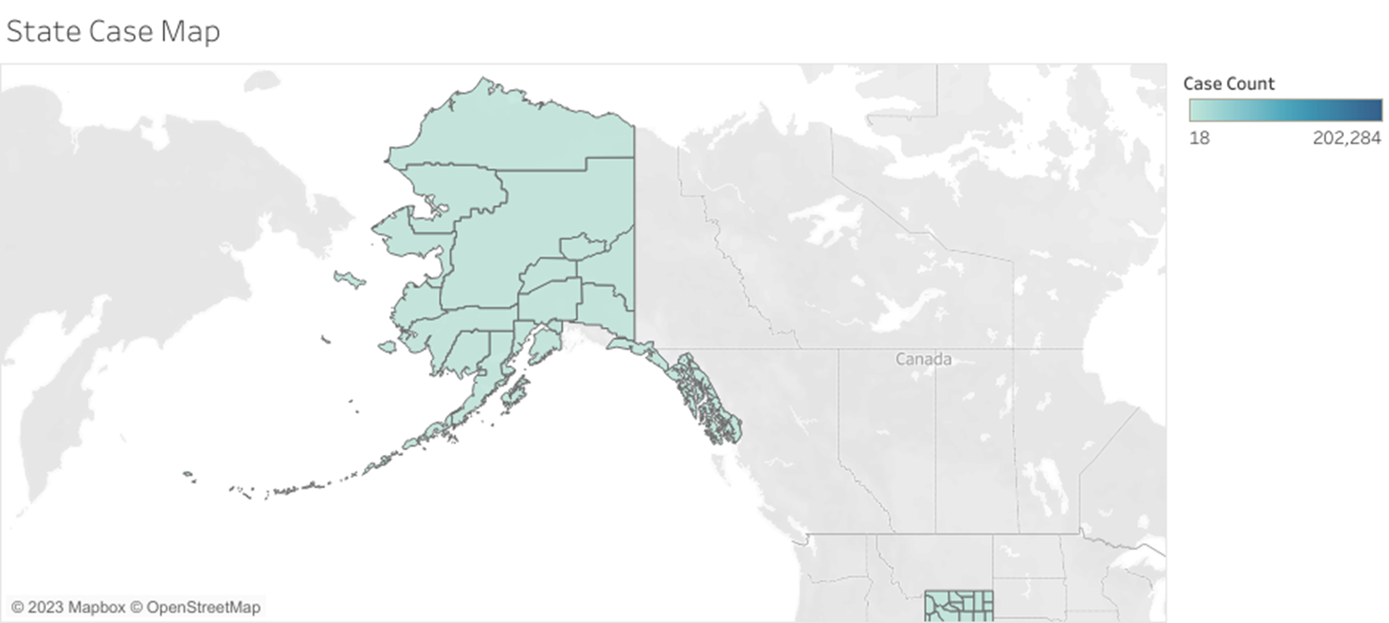

Slide 11
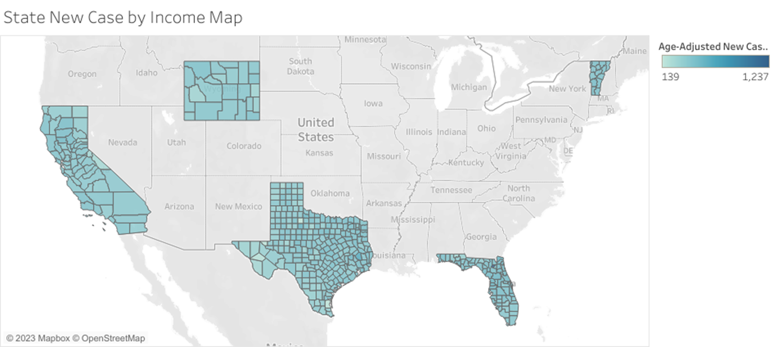

Slide 12
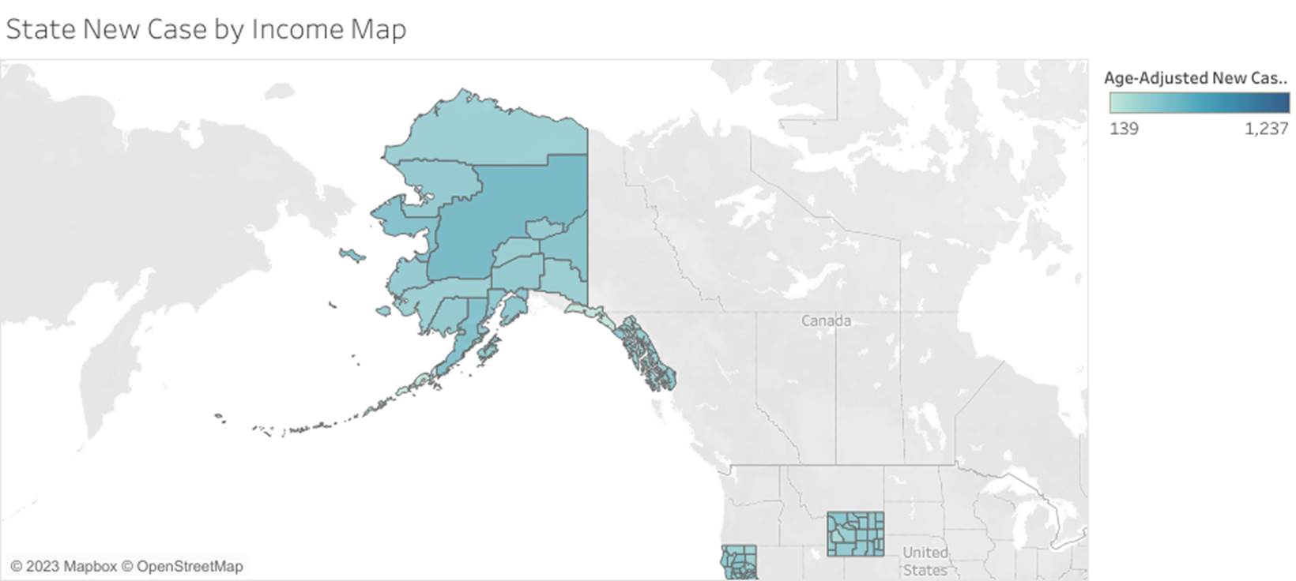

Slide 13
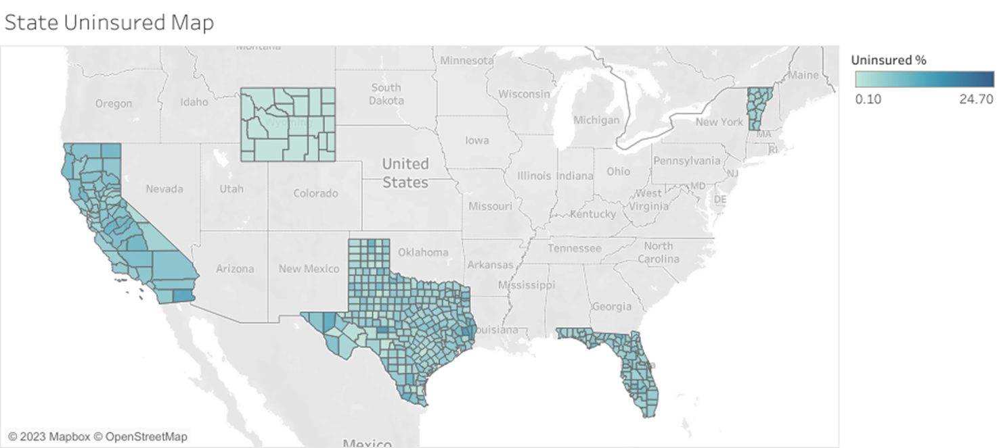

Slide 14
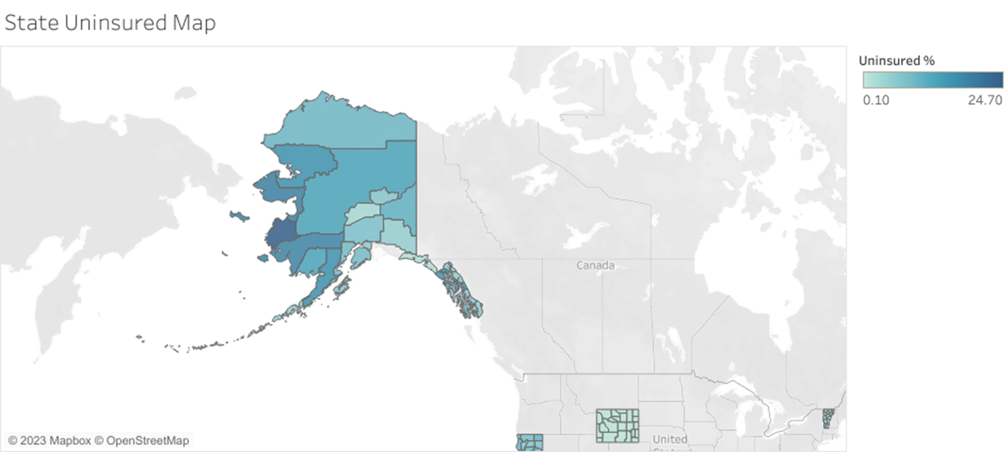

Slide 15
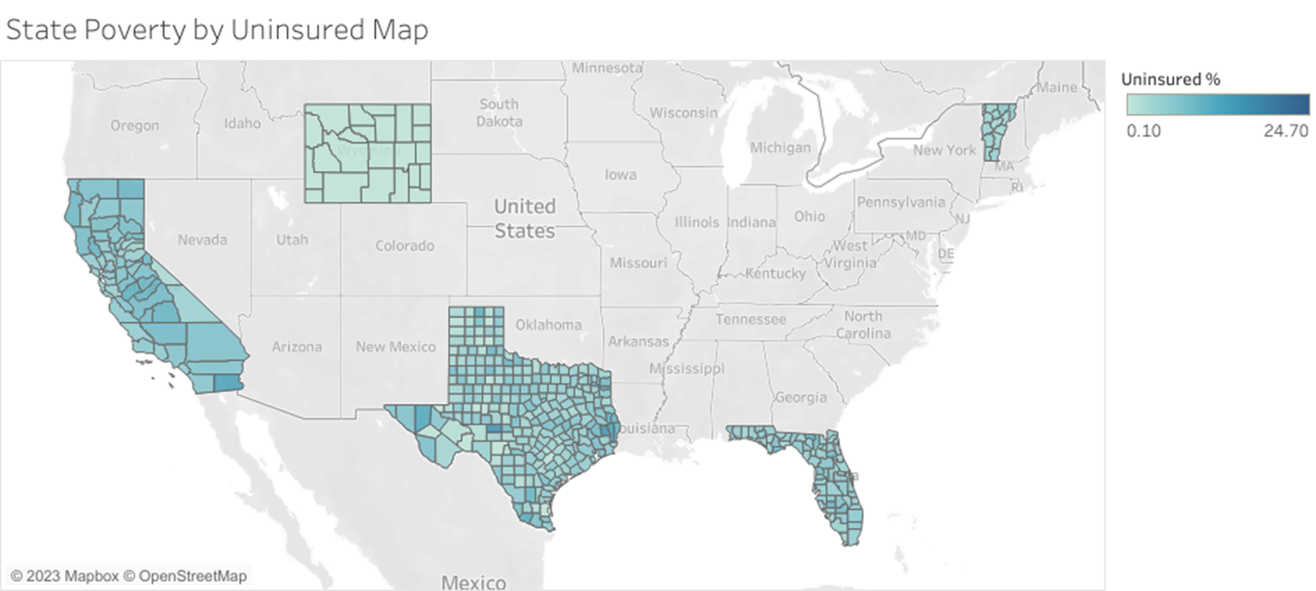

Slide 16
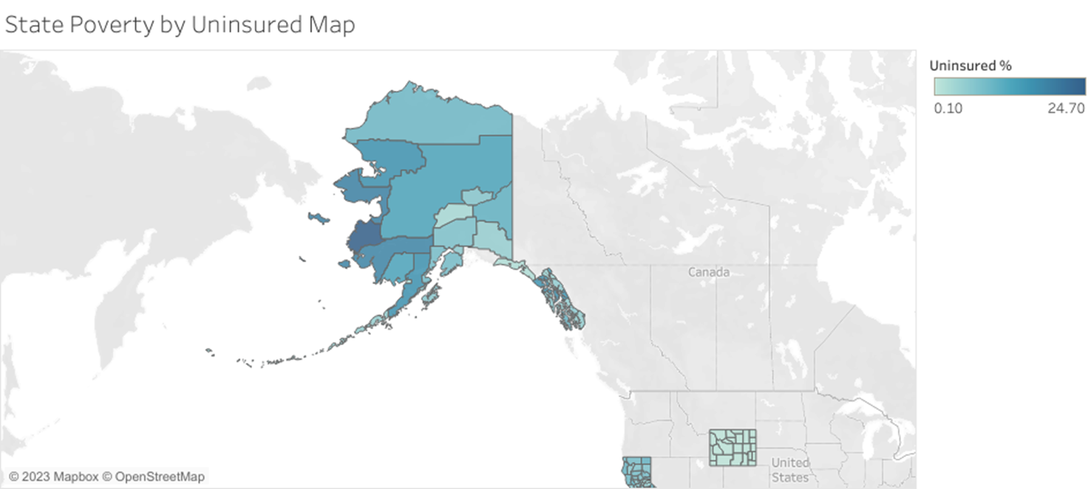

Slide 17
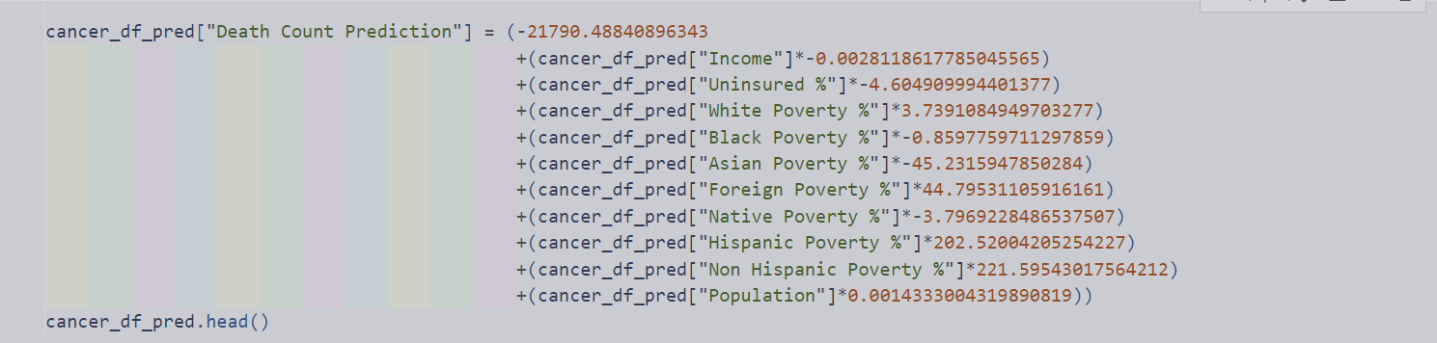
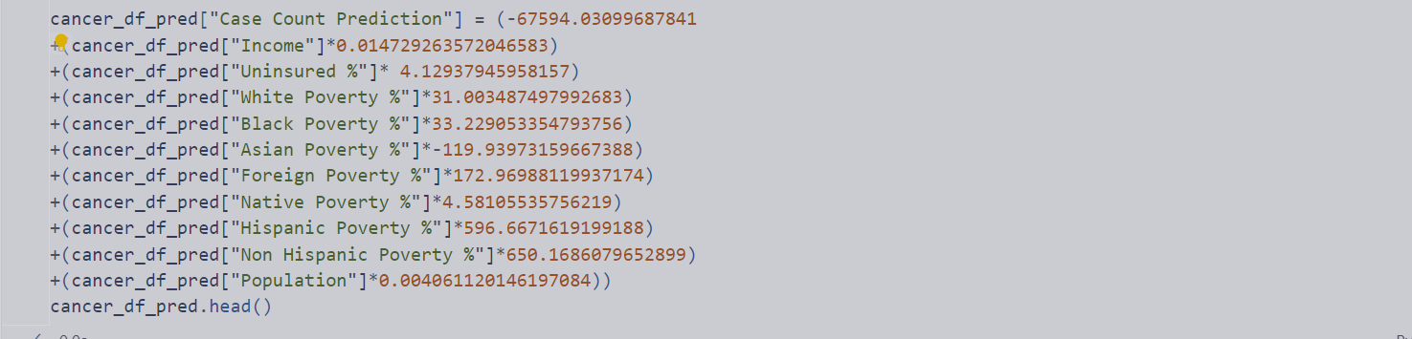
Two different linear equations were made for new cancer cases and cancer deaths numbers
NewCase R² = 97.57
Death Count R² = 97.69
The strongest coefficients overall are the poverty rates
The weakest being population

Slide 18
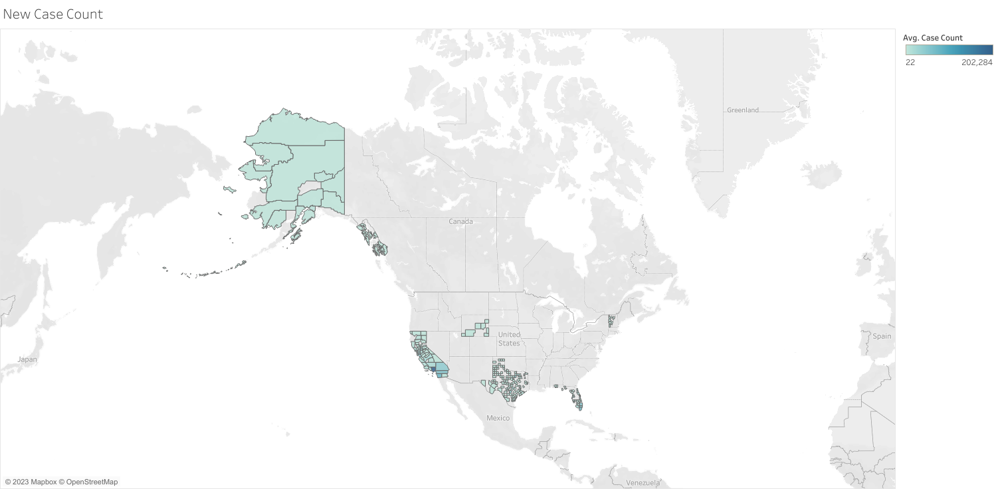
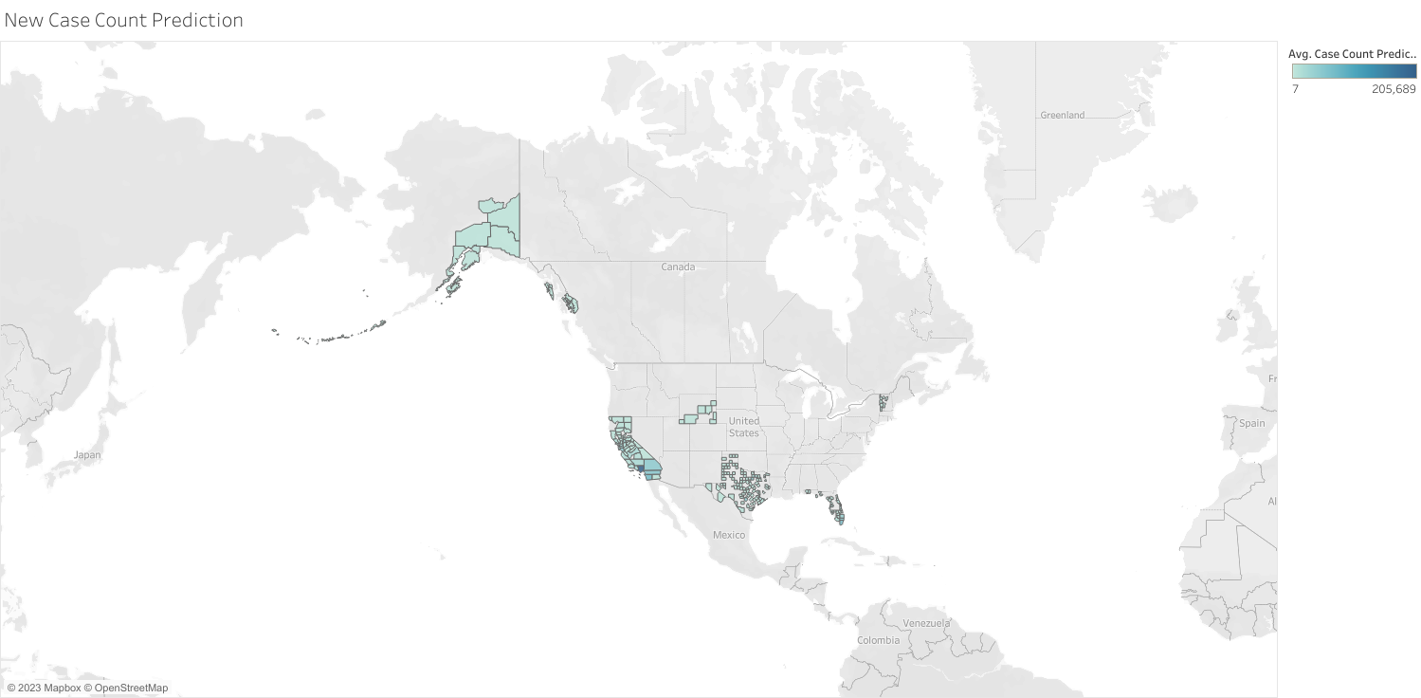
Actual New Case Count
Predicted New Case Count

Slide 19
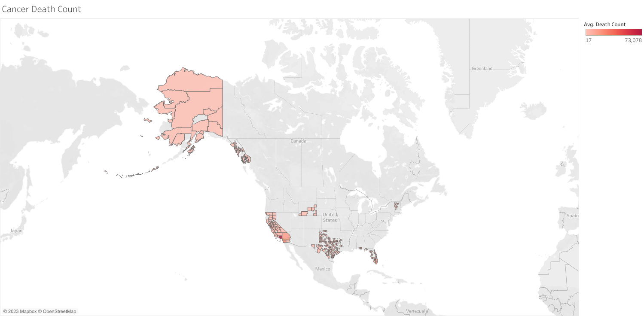
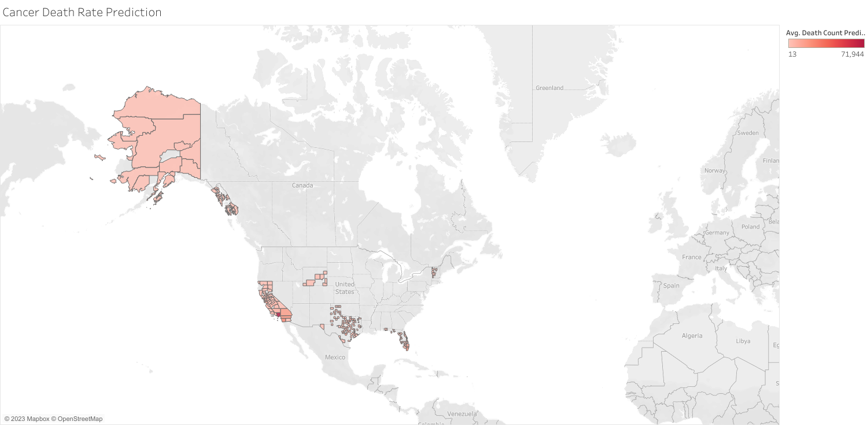
Actual Cancer Death Counts
Predicted Cancer Death Counts

Slide 20
Actual Cancer Death Counts
Predicted Cancer Death Counts

Slide 21
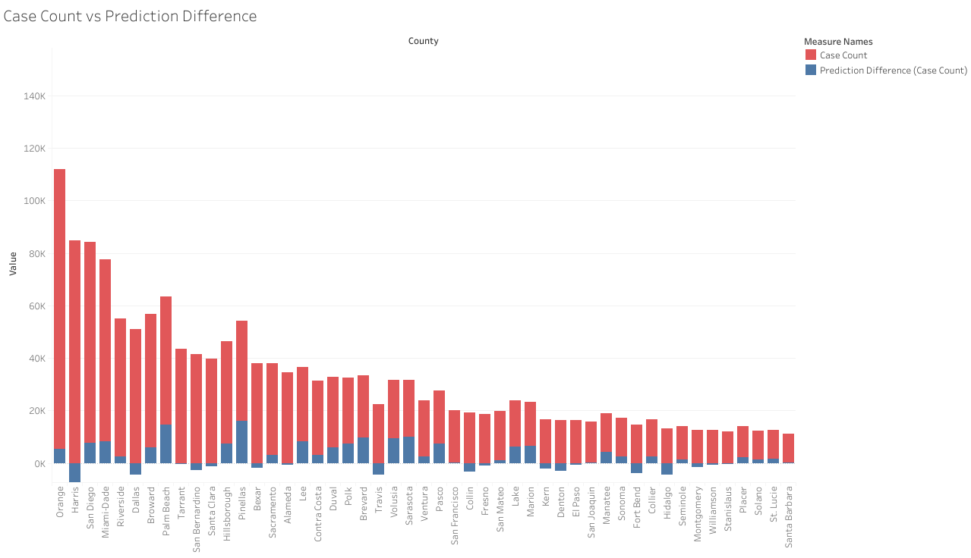
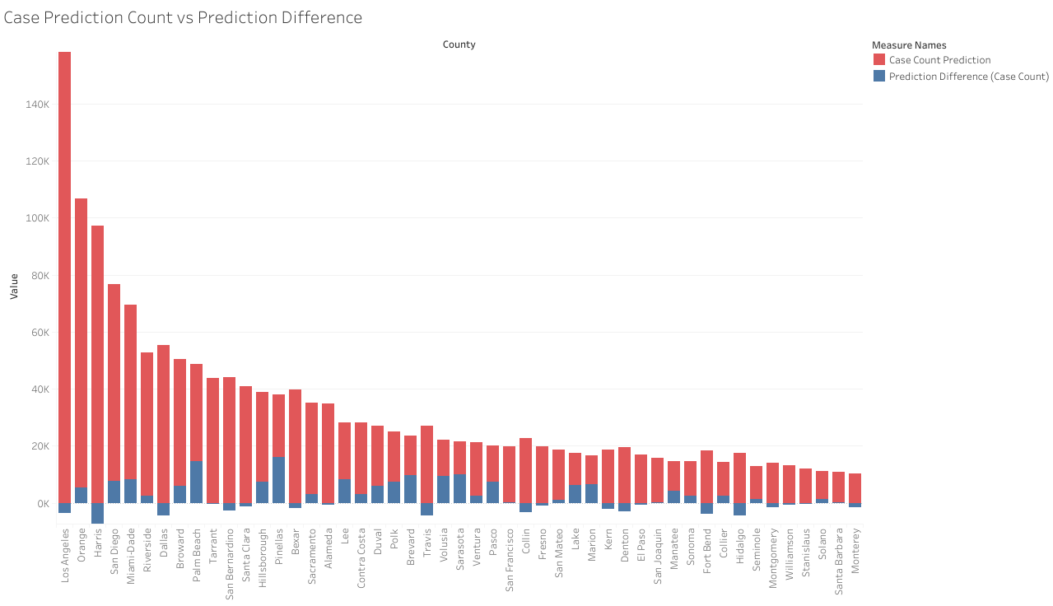
Case Count & Prediction Difference
Most differences are due to overshoot
The lower the original value the smaller the difference
Case Count Prediction & Prediction Difference

Slide 22
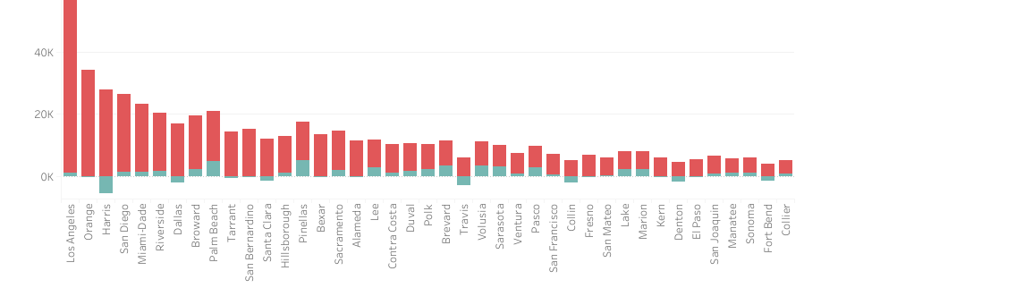
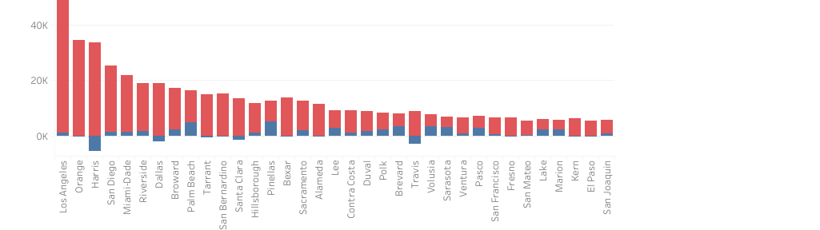
Death Count & Prediction Difference
Death count differences are smaller overall compared to Case count
Death Count Prediction & Prediction Difference

Slide 23
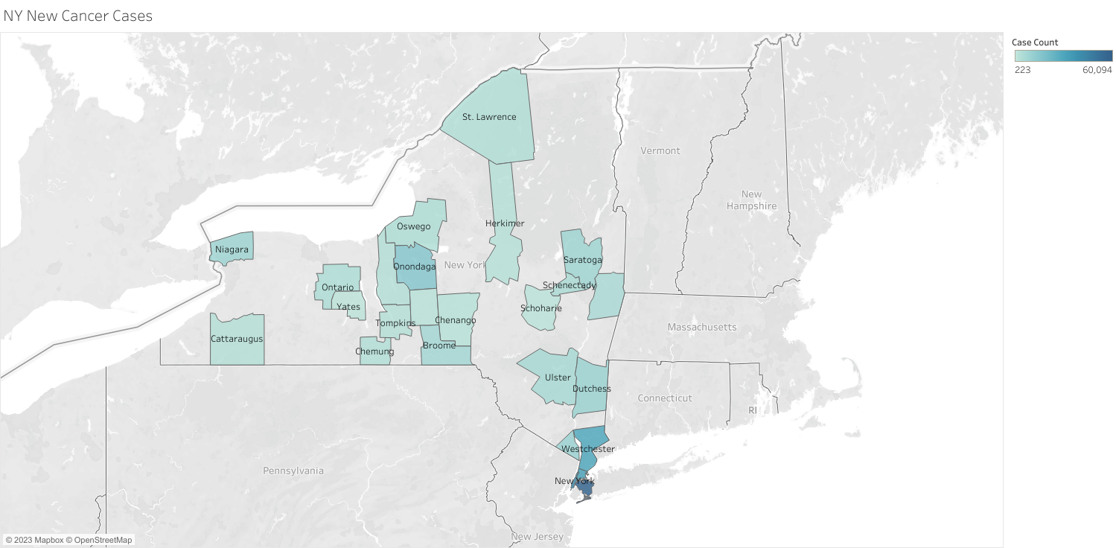
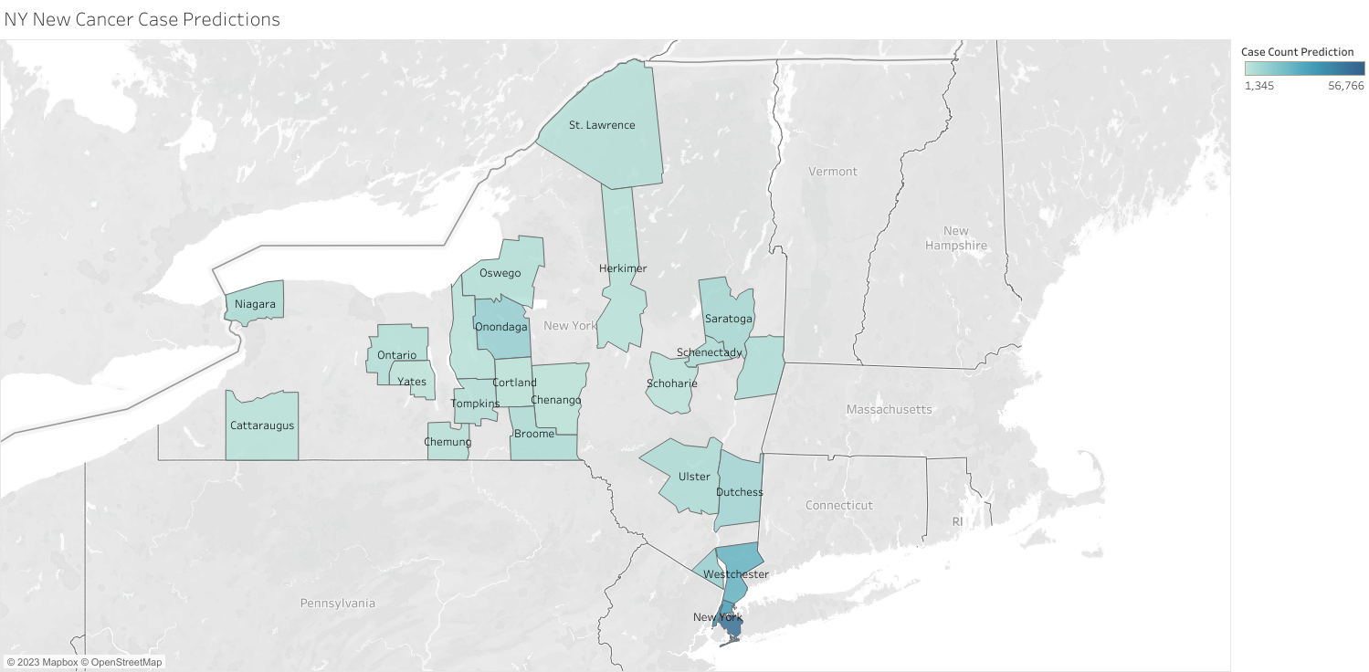
Actual New Case Count
Predicted New Case Count

Slide 24
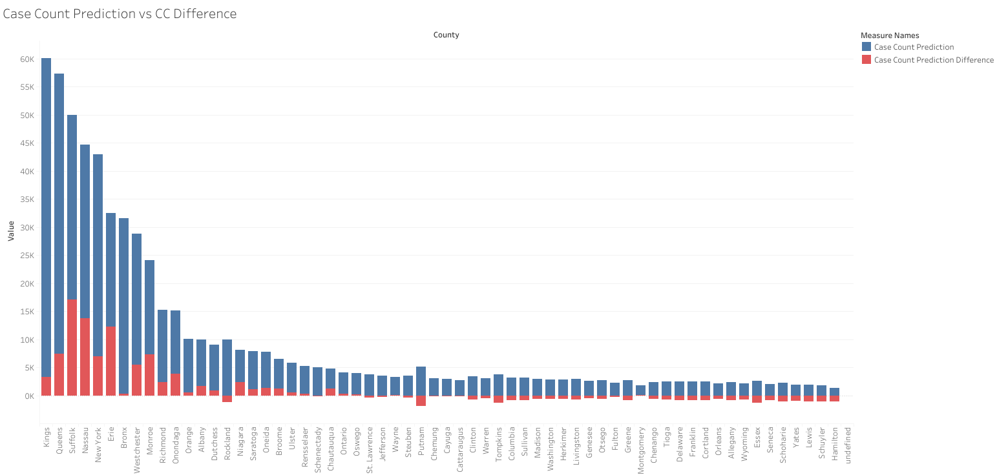
Similar results to testing case counts but higher differences
More negative differences as case counts decrease

Slide 25
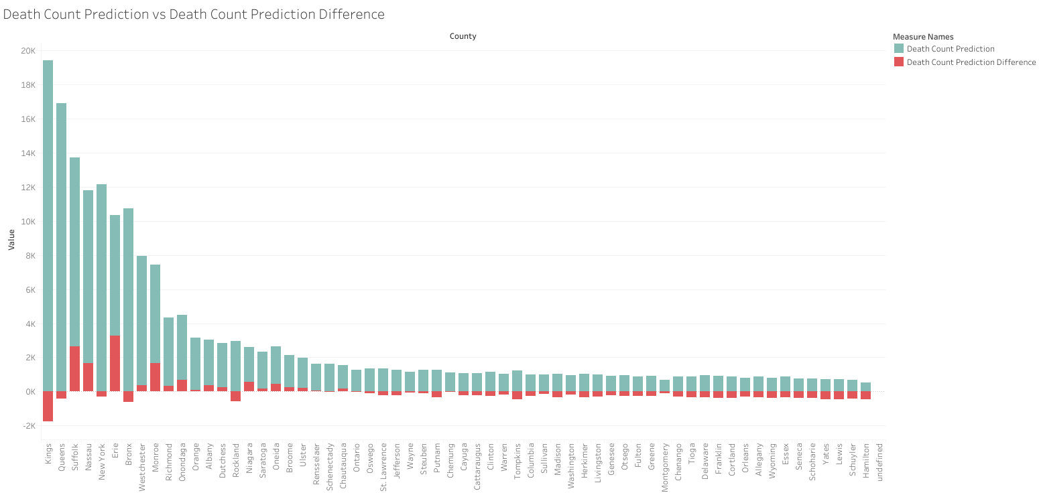

Slide 26
Conclusion
MLR can be helpful to give a broad prediction on case numbers
Factors like poverty, income, and insurance status can affect case numbers and death count
Prediction modeling should be used for finding high risk areas
Outside factors that can’t be accounted for also affect results

Slide 27

Questions?

Slide 28
Datasets:
United States Cancer Statistics:
https://gis.cdc.gov/Cancer/USCS/#/CongressionalDistricts/
NCI Cancer Demographics:
https://gis.cancer.gov/canceratlas/tableview/?d=4&a=1&r=2&s=6

